Slide 1
Quantifying Electrostatic Fields at Protein Interfaces Using Classical Electrostatics Calculations
Andrew W. Ritchie
Adviser: Lauren J. Webb
The University of Texas at Austin
Department of Chemistry

Slide 2
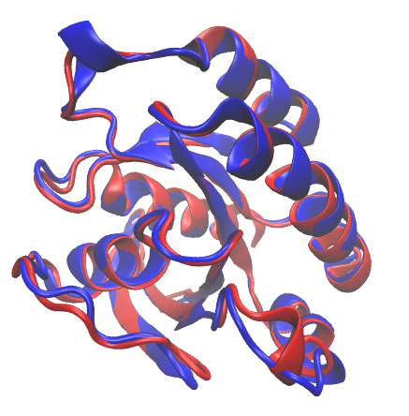
Why Study Protein Electrostatics?
50% amino acid identity
80% amino acid homology
0.7 Å effector binding surface RMSD
Ragain, et. al., J. Phys. Chem. B 2012
Huang, et. al., Nat. Struct. Bio. 1998
Nassar, et. al., Nat. Struct. Bio. 1996
Notes:
----- Meeting Notes (8/3/15 16:30) -----
remove text about how identical, and just say "almost identical"

Slide 3
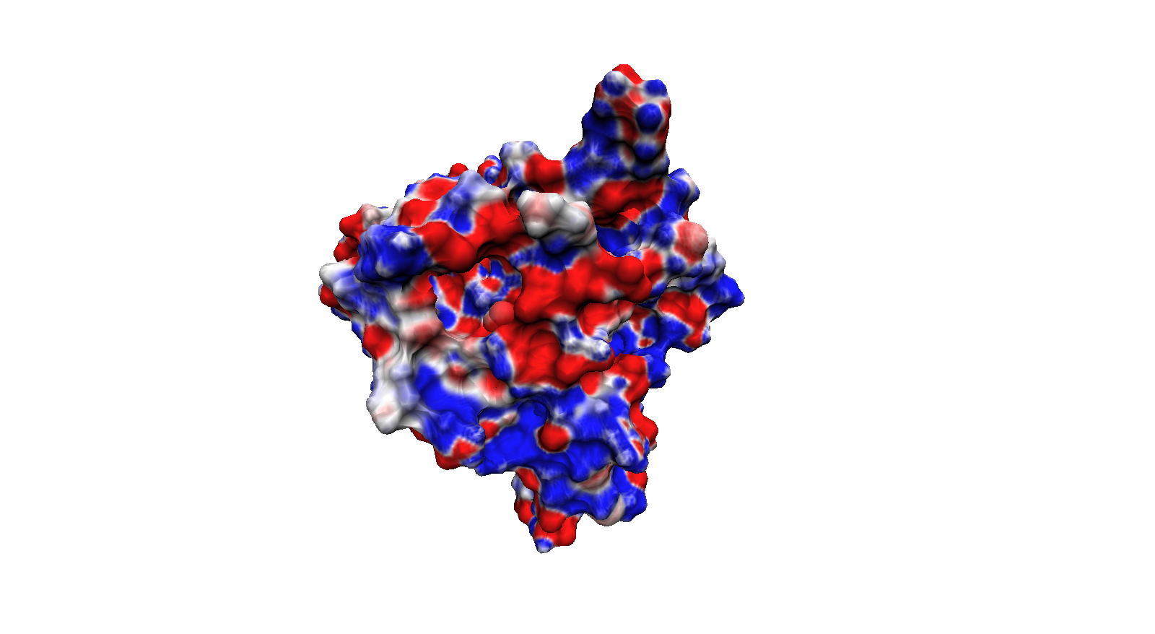
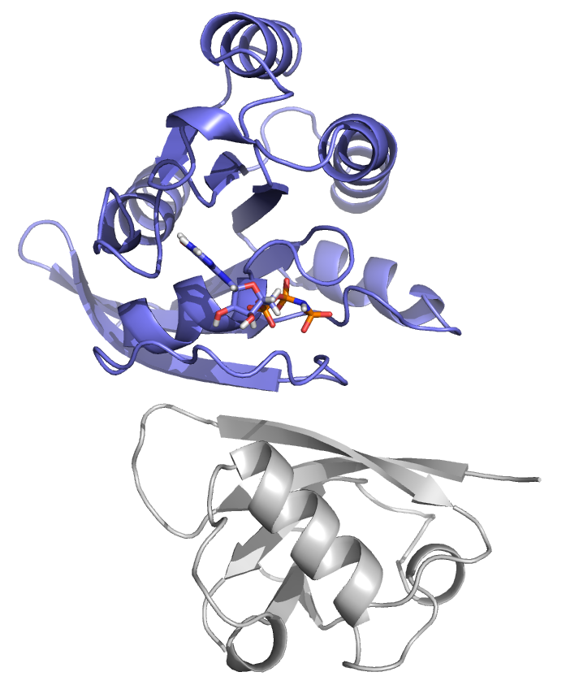
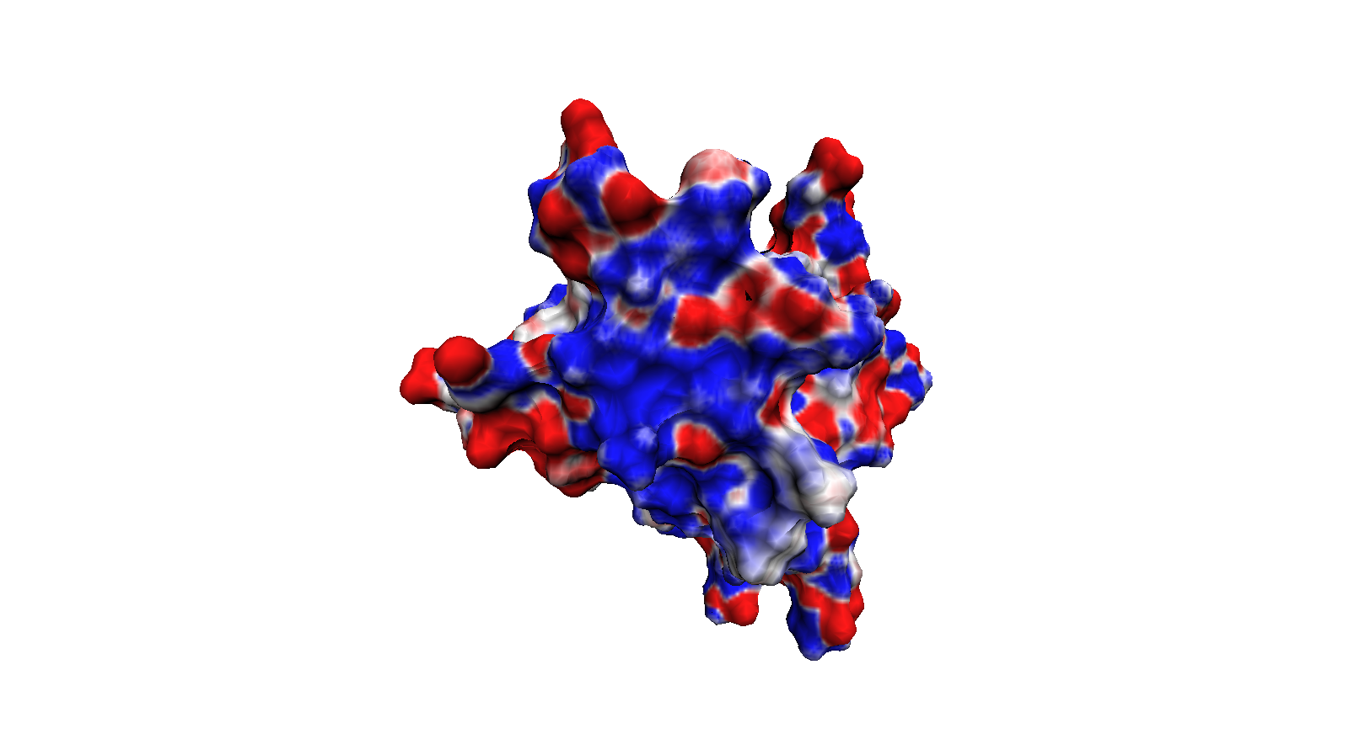
Why Study Protein Electrostatics?
≥ +25 MV/cm
≤ -25 MV/cm
Notes:
----- Meeting Notes (8/3/15 16:37) -----
scale bar is wrong

Slide 4
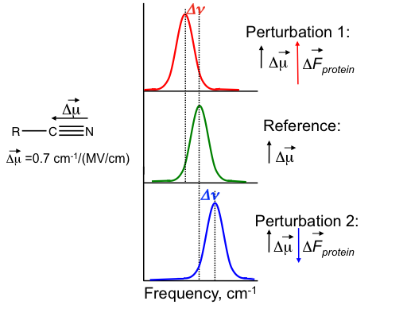
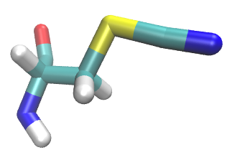
Probing Protein Electrostatics Using the Vibrational Stark Effect (VSE)
Notes:
----- Meeting Notes (8/3/15 16:37) -----
spent too long on VSE

Slide 5
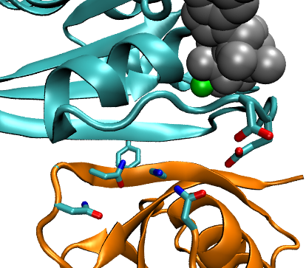
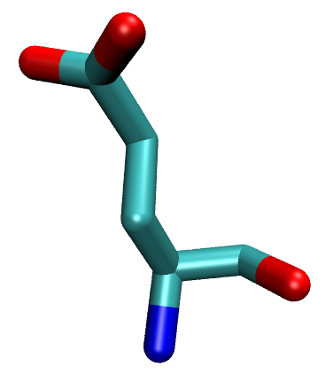
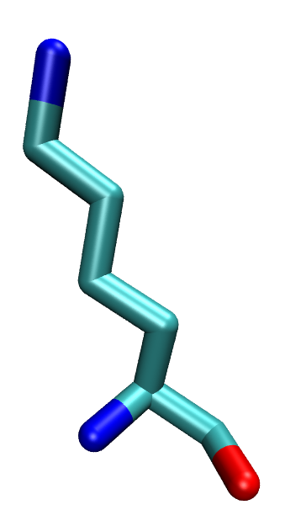
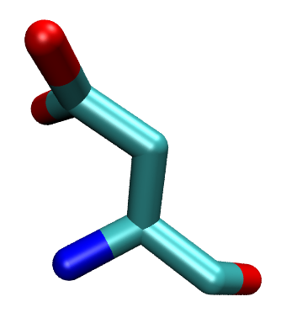
Goal: Validate Computational Electrostatic Techniques Against Experimental Stark Shifts
Rap1a
Glutamic Acid
Lysine (WT)
Position 30
E30D
Position 31
Y31
G28
K32
K31E
N29
Aspartic Acid
N54
Glutamic Acid
N27
Ralβ
Ragain, et. al., J. Phys. Chem. B 2012
Notes:
I just quickly wanted to remind everyone of what I’m doing and why I’m doing it.
My group is using the vibrational Stark effect to look at the electrostatic environment at the protein protein interface. My goal is to model my group’s experimental system to allow interpretation and prediction of our experimental results. To do this I’m using molecular dynamics to generate an ensemble of protein structures on which I solve the linear poisson-boltzmann equation for and calculate a Boltzmann-weighted average field at the probe.

Slide 6
Goal: Validate Computational Electrostatic Techniques Against Experimental Stark Shifts
Ragain, et. al., J Phys. Chem. B 2012
Notes:
I just quickly wanted to remind everyone of what I’m doing and why I’m doing it.
My group is using the vibrational Stark effect to look at the electrostatic environment at the protein protein interface. My goal is to model my group’s experimental system to allow interpretation and prediction of our experimental results. To do this I’m using molecular dynamics to generate an ensemble of protein structures on which I solve the linear poisson-boltzmann equation for and calculate a Boltzmann-weighted average field at the probe.

Slide 7
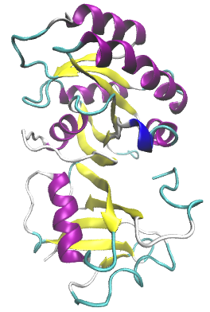
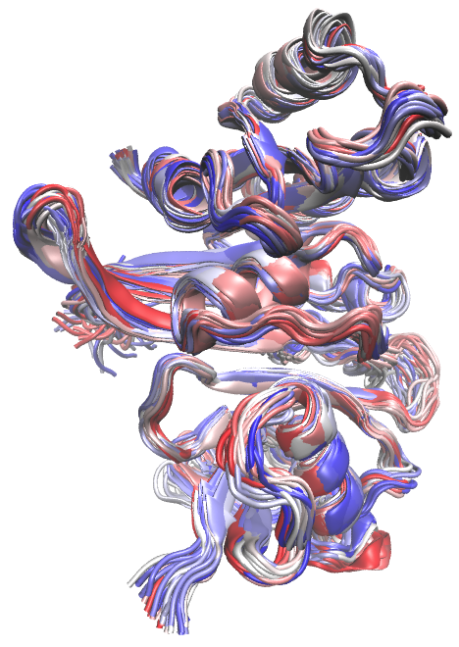
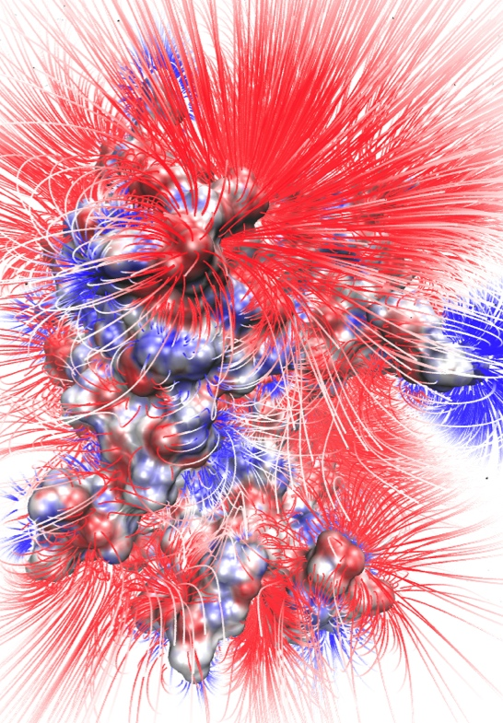
Computational Approach
PDB Structure
MD Ensemble
Electrostatic Field
Electrostatics Model
≤ -1.5
MV/cm⁻¹
T _{initial}
T _{final}
≥ +1.5
MV/cm⁻¹
Notes:
----- Meeting Notes (8/3/15 16:37) -----
Add iterate/compare to experiment
1. something people can use to predict interesting experiments
2. better molecular understanding and therefore ability to ask interesting physics questions

Slide 8
Enhanced Molecular Dynamics: Umbrella Sampling

Slide 9
Enhanced Molecular Dynamics: Umbrella Sampling

Slide 10
Enhanced Molecular Dynamics: Umbrella Sampling

Slide 11
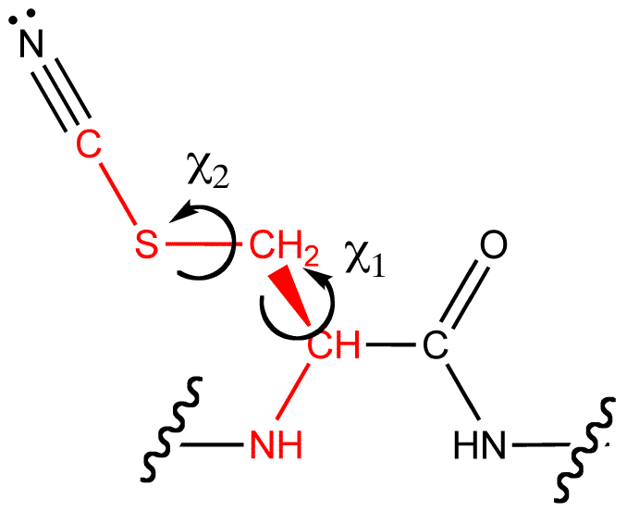
Enhanced Molecular Dynamics: Umbrella Sampling
χ₂ (Degrees)
χ₁ (Degrees)
Notes:
----- Meeting Notes (8/3/15 16:38) -----
Be sure

Slide 12
2D-probability distributions: a test case
High Probability
Low Probability
Notes:
Now one of the first things I wanted to do after deciding to do a 2D sampling strategy was to make sure I knew what to expect from an alkane-like molecule and test the Weighted Histrogram Analysis code my group uses on a 2D system.
To do this I modeled a fictional molecule in which the only contribution to its energy are the chi1 and chi2 dihedral angles, which were each modeled independently using a Ryckaert-Belleman potential function. The main point I wanted to show here is that in 2 dimensions, the probability looks like the product of the 1 dimensional probabilities for an alkane molecule and that, for a perfect test case, I can reproduce the analytic probability distribution.

Slide 13
Computational Approach
PDB Structure
MD Ensemble
Electrostatic Field
Electrostatics Model
≤ -1.5
MV/cm⁻¹
T _{initial}
T _{final}
≥ +1.5
MV/cm⁻¹

Slide 14
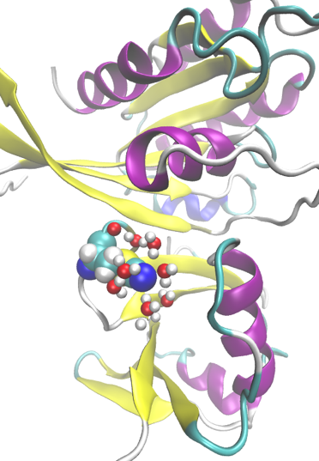
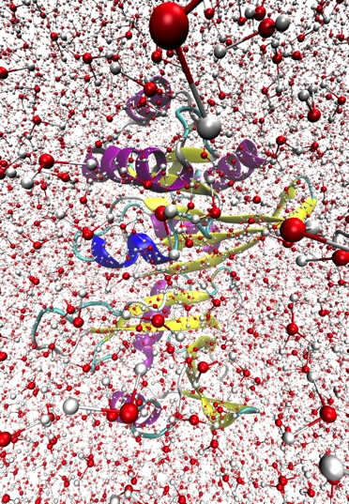
Electrostatics Models
PB Implicit Solvent | PB w/ Selected Explicit Water | Explicit Solvent
AMOEBA | AMOEBA-CP | AMOEBA-CPf
Notes:
----- Meeting Notes (8/3/15 16:39) -----
Waaaaaaaaaay too much detail

Slide 15
Electrostatics Models
PB Implicit Solvent | PB w/ Selected Explicit Water
Notes:
----- Meeting Notes (8/3/15 16:52) -----
Add AMOEBA (be vague)
Go vertical
Be sure to say what PB is
Don't use an equation

Slide 16
Linear Poisson-Boltzmann Equation

Slide 17
PB: Reaction Field Method (RFM)
Notes:
Don’t forget to talk about the grid points, you need it for the next couple slides
----- Meeting Notes (8/3/15 16:52) -----
Talk about why I had to do this and why just PB didn't work very well. It came out of no where
It's now part of APBS
Colors need to be redone
A should be solvated (-) reference = srf

Slide 18
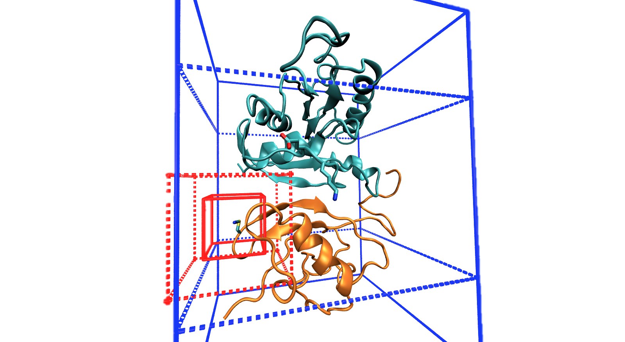
PB: Grid Location
Original box
New box
Notes:
Finally, I’m also working on a set a even coarser grid-spacings in which the second stage boxes encompass approximately half and approximately all of the protein each. The idea here is to determine whether the box size or the grid spacing is more important. I do not yet have any examined data for this strategy.
Because APBS is very highly tunable, one of the challenges is determining which parameters are most important and whether or not it’s physically reasonable. Right now, focusing on the box positions, I’m trying to come up with a consistent metric for determining how to decide the location, size, and grid spacing that is the most useful combination of accurate and quick.

Slide 19
PB: Grid Location
Numeric Field
RFM Field
Calculated Field
(k_{b}T/eÅ)
Experimental Absorption Energy (cm⁻¹)
Calculated Change
in Field (k_{b}T/eÅ)
Experimental Change in Absorption Energy (cm⁻¹)
Notes:
----- Meeting Notes (8/3/15 16:52) -----
In the title, give size and GS info

Slide 20
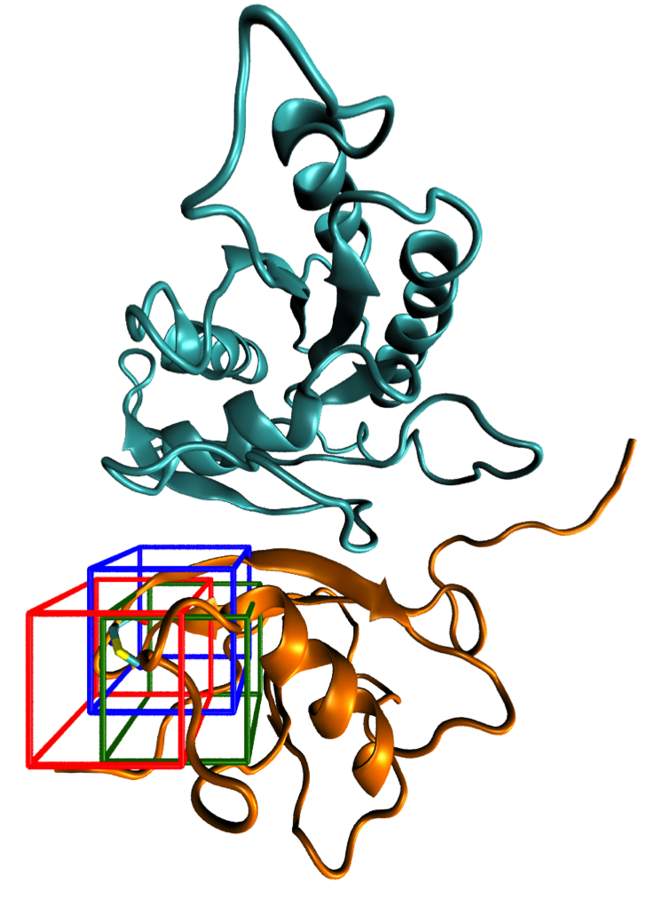
PB: Grid Location
Red: Center of nitrile Cδ
Blue: Shifted towards system center of mass
Green: Shifted towards Ralβ center of mass

Slide 21
PB: Grid Location
Numeric Field
RFM Field
Calculated Field
(k_{b}T/eÅ)
Calculated Field
(k_{b}T/eÅ)
Experimental Absorption Energy (cm⁻¹)
Experimental Absorption Energy (cm⁻¹)
Calculated Change
in Field (k_{b}T/eÅ)
Calculated Change
in Field (k_{b}T/eÅ)
Experimental Change in Absorption Energy (cm⁻¹)
Experimental Change in Absorption Energy (cm⁻¹)
Notes:
----- Meeting Notes (8/3/15 16:52) -----
Add Key

Slide 22
PB: Grid Location
Numeric Field
RFM Field
Calculated Field
(k_{b}T/eÅ)
Experimental Absorption Energy (cm⁻¹)
Calculated Change
in Field (k_{b}T/eÅ)
Experimental Change in Absorption Energy (cm⁻¹)

Slide 23
Conclusions
Fields calculated via PB are sensitive to the grid location, even for calculating the field at a single point in space
The larger box is more insensitive to grid location
The RFM is more insensitive to grid location
The difference calculation systematically improves correlations with experiment for the purely numeric PB solution and not for the RFM. Possible that a nonphysical error is cancelled out by taking a difference calculation, which is reintroduced via the RFM
Notes:
----- Meeting Notes (8/3/15 16:52) -----
GIVE ADVICE ABOUT DOING THESE, maybe remove verbage

Slide 24
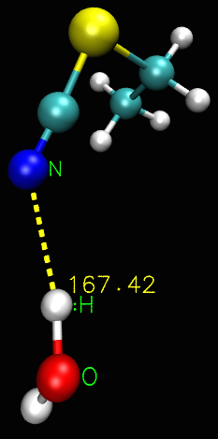
PB: Including Selected TIP3P Water Molecules: All within 5 Å, Nearest, Hydrogen-Bonding
N-H-O
r_{NH} ≤ 2.25 Å
NHO ≥ 138˚
Le Questel, et al. J Phys. Org Chem 2000
Notes:
----- Meeting Notes (8/3/15 16:52) -----
Add Schiffer
Redo background color
Trying to be very generous

Slide 25
PB: Including Selected TIP3P Water Molecules
Numeric Field
RFM Field
If a water was within 5 Å of the nitrile, it remained within 5 Å for an average of 20±4.2 frames
Calculated Field
(k_{b}T/eÅ)
Experimental Absorption Energy (cm⁻¹)
Calculated Change
in Field (k_{b}T/eÅ)
Experimental Change in Absorption Energy (cm⁻¹)
Notes:
----- Meeting Notes (8/3/15 16:52) -----
Again, in title give the calculation info (5 AA sphere)
Add key
Keep info about number of frames in my pockets

Slide 26
PB: Including Selected TIP3P Water Molecules
Numeric Field
RFM Field
Calculated Field
(k_{b}T/eÅ)
Experimental Absorption Energy (cm⁻¹)
Calculated Change
in Field (k_{b}T/eÅ)
Experimental Change in Absorption Energy (cm⁻¹)
Notes:
----- Meeting Notes (8/3/15 16:52) -----
Fix cropping

Slide 27
PB: Including Selected TIP3P Water Molecules
Numeric Field
RFM Field
9.92% of frames had a nitrile-water hydrogen bond
Calculated Field
(k_{b}T/eÅ)
Experimental Absorption Energy (cm⁻¹)
Calculated Change
in Field (k_{b}T/eÅ)
Experimental Change in Absorption Energy (cm⁻¹)

Slide 28
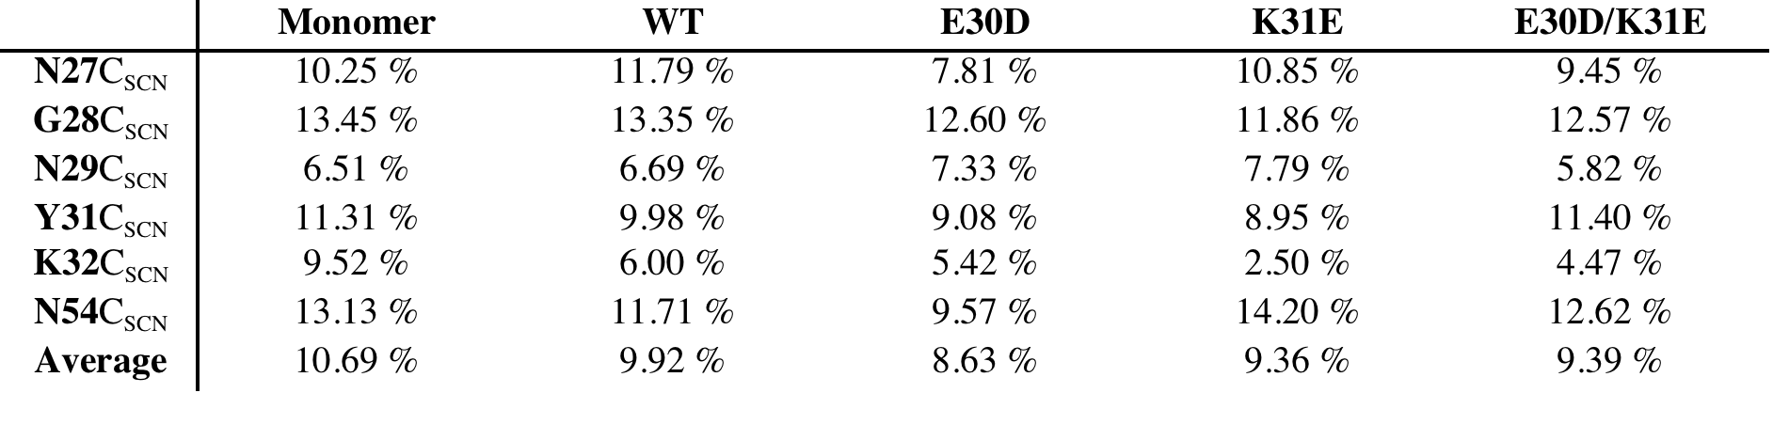
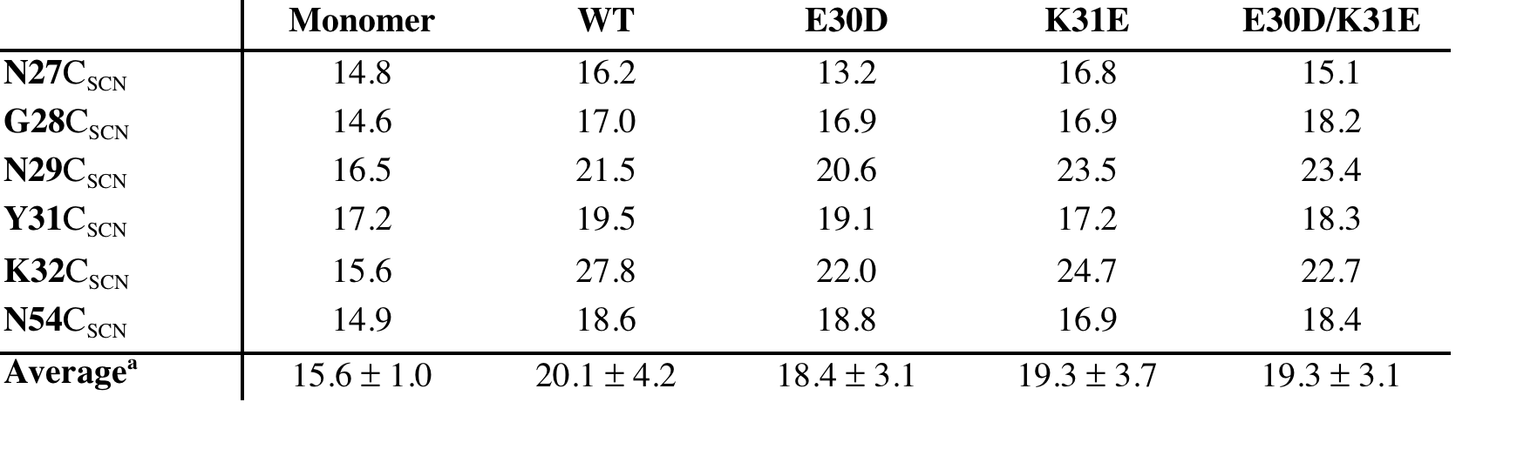
PB: Including Selected TIP3P Water Molecules
Percentage of Frames with a Nitrile-Water Hydrogen Bond
Average Number of Frames Water Remained within 5 Å of Nitrile

Slide 29
Conclusion
Explicit inclusion of nearby water does not systematically change the correlation with experimental data
Few water molecules are hydrogen bonding
Again, for the numeric method, the relative field correlations are increased relative to the absolute field correlations. For the RFM, no such systematic change is observed.
Notes:
----- Meeting Notes (8/3/15 16:18) -----
While we have had some successes, they ALL have to be justified after the fact
----- Meeting Notes (8/3/15 16:52) -----
GIVE ADVICE, no summary

Slide 30
Stop here

Slide 31
The Case for Electronic Polarizability: AMOEBA
Notes:
----- Meeting Notes (8/3/15 16:18) -----
backup

Slide 32
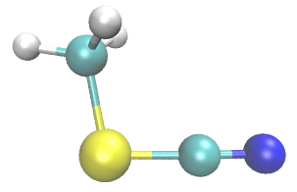
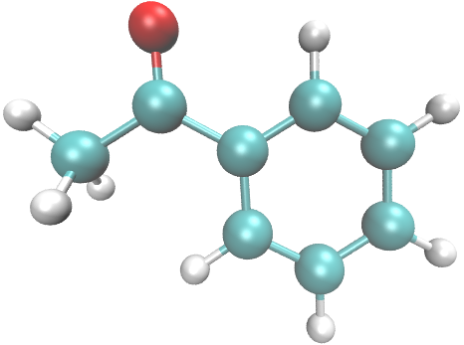
The Case for Electronic Polarizability: AMOEBA
Ragain, Slocum, Eklund
Fried, S. D., et al. J Am Chem Soc 2013.
Notes:
----- Meeting Notes (8/3/15 16:18) -----
Backup

Slide 33
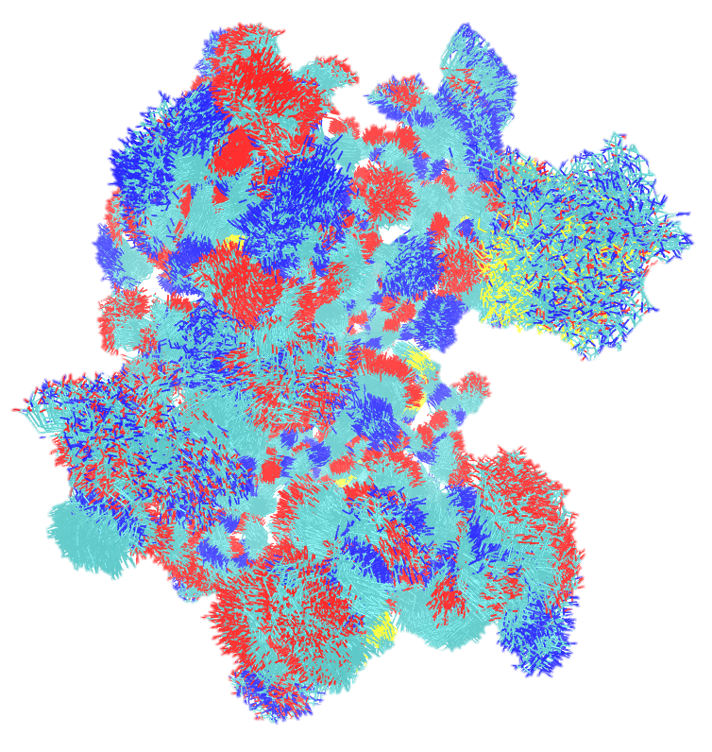
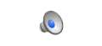
Explicitly Modeling Electronic Polarizability: AMOEBA
Notes:
----- Meeting Notes (8/3/15 16:18) -----
go from here
----- Meeting Notes (8/3/15 16:52) -----
start here

Slide 34
AMOEBA Fields From Amber03 Structural Ensembles Are Less Correlated to Experiment than PB Fields

Slide 35
Conclusion
For systems where dynamics were generated in a point charge force field (Amber03), fields calculated via the polarizable AMOEBA force field are generally worse than those calculated using PB with point charges
It is likely that the ensembles are not transferable; Amber03 includes orientational polarization (via MD), while AMOEBA incorporated both orientational (via MD) as well as electronic polarization, and low energy orientations likely differ.
Dynamics should likely be performed in AMOEBA; further work is in progress in our lab to test this hypothesis
Notes:
----- Meeting Notes (8/3/15 16:52) -----
1. summary
2. & 3. conclusions

Slide 36
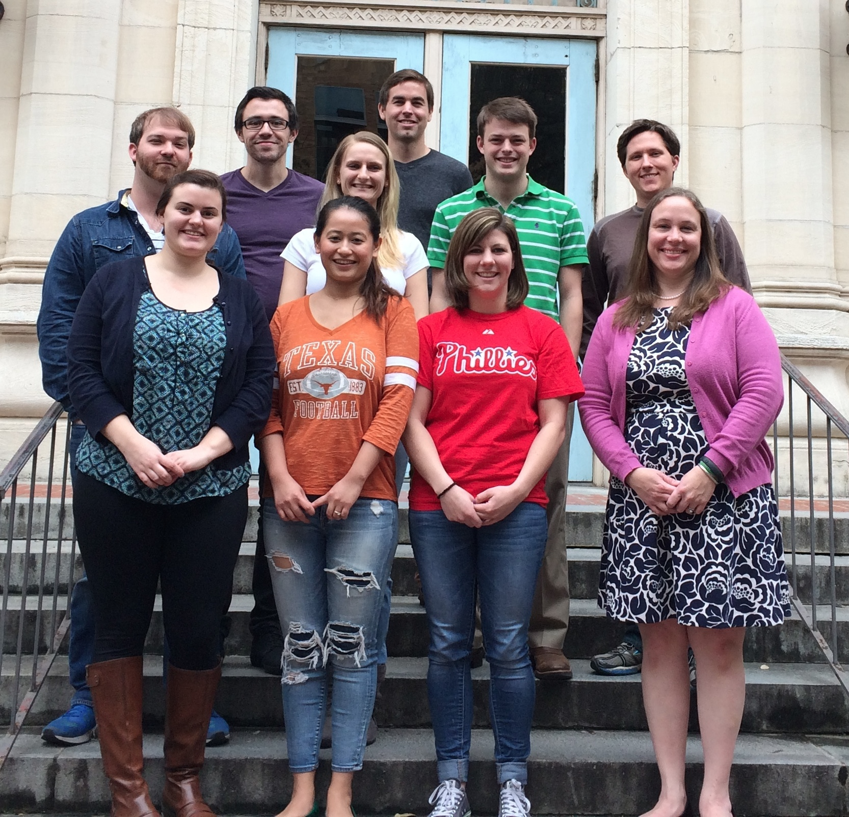
Acknowledgements
Advisor
Lauren J. Webb, Ph.D.
Graduate Students
Cari Anderson
Jason Dugger
Whitney Fies
Jeremy First
Seth Norman
Elisa Novelli
Rebika Shrestha
Josh Slocum
Previous Graduate Students and Post Docs
Daniel Ensign, Ph.D.
Christina Ragain, Ph.D.
Kjell Schroder, Ph.D.
Amy Stafford
David Walker, Ph.D.
Undergraduates
Kelsey Eklund
Santiago Sanchez
Funding
Burroughs Wellcome Fund
The Welch Foundation
The University of Texas at Austin
Collaborators
Pengyu Ren (Biomedical Engineering)
Michael Schnieders (Iowa)
Facilities
TI3D
TACC

Slide 37
Calculating Fields in AMOEBA

Slide 38
Potential, Field, and Induced Dipole Expressions

Slide 39
Electrostatic Frame Clustering: Taking advantage of a weighted average

Slide 40
Electrostatic Frame Clustering: Taking advantage of a weighted average

Slide 41
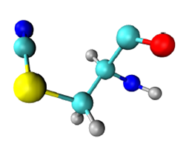
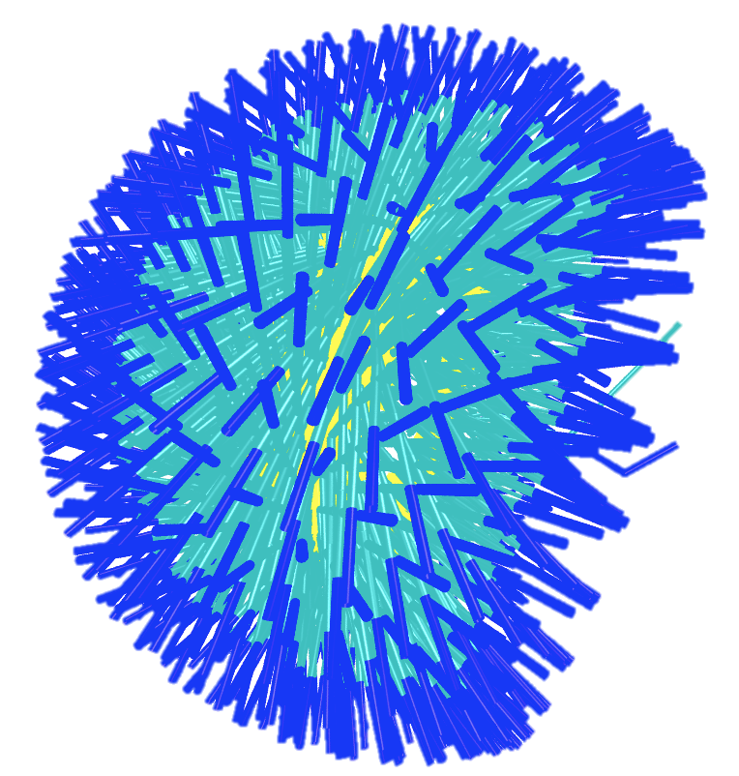
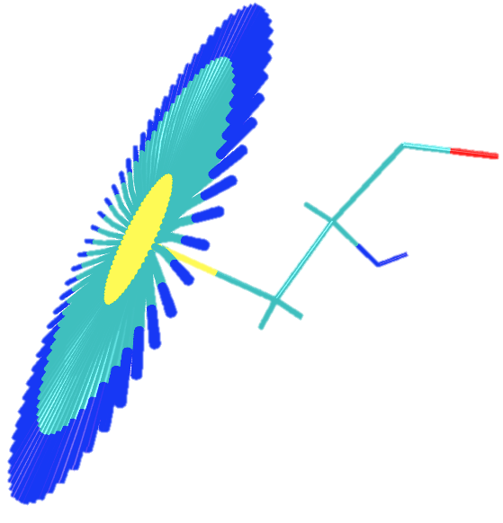
MD: sampling methods
Old (1D)
χ₁
18 ns
New (2D)
χ₁ + χ₂
57.6 ns
Cδ
Cα
Sγ
N
Cβ
χ₁
χ₂
Notes:
The most impactful difference between sampling two degrees of freedom rather than one are the dipole moment vectors of the nitrile probe. The reason for using umbrella sampling is because there are potential energy barriers that are not likely to be surpassed over a reasonable simulation time at biologically relevant temperatures. The nitrile probe used has two relevant torsional degrees of freedom beyond the backbone. By just biasing a single degree of freedom, chi 2, an ensemble of structures are generated which nearly all have the same chi 1 dihedral and incompletely samples the 3 dimensional dipole vector space.
Using 2D umbrella sampling, however, creates a more-complete picture of probe dipole vectors, which is relevant for the magnitude of the VSE.

Slide 42
2D-WHAM
Convert 2D-problem to 1D-problem
Bin(0,0)=0, Bin(0,1)=1, …
For 72x72 5º bins, 5184 total bins
Convert 1D python script to C++
Bug found! Fix and test against known potential
Ryckaert-Bell alkane potential:
C_{n}={9.28, 12.16, -13.12, -3.06, 26.24, -31.5}

Slide 43
Stark turning rate and dielectric constant
Stark effect
Linear PBE

